Slide 1

Chapter 8 Part 3
Advanced SQL
The slides in this presentation have been adapted from slides provided with the textbook, Database Systems: Design, Implementation, and Management,
12E, Cornel and Morris, Copyright © 2017 Cengage Learning.

Slide 2
Learning Objectives
Create and use triggers and stored procedures
Describe how to create embedded SQL
Copyright © 2017 Cengage Learning
2

Slide 3
Oracle Sequences
Independent object in the database
Have a name and can be used anywhere a value expected
Not tied to a table or column
Generate a numeric value that can be assigned to any column in any table
Table attribute with an assigned value can be edited and modified
Can be created and deleted any time
Copyright © 2017 Cengage Learning
3

Slide 4
Oracle Sequences
CREATE SEQUENCE CUS_CODE_SEQ START WITH 20010 NOCACHE;
INSERT INTO CUSTOMER
VALUES (CUS_CODE_SEQ.NEXTVAL, 'Connery', 'Sean', NULL, '615', '898-2007', 0.00);
Copyright © 2017 Cengage Learning
4

Slide 5
Procedural SQL
Performs a conditional or looping operation by isolating critical code and making all application programs call the shared code
Yields better maintenance and logic control
Persistent stored module (PSM): Block of code containing:
Standard SQL statements
Procedural extensions that is stored and executed at the DBMS server
Copyright © 2017 Cengage Learning
5

Slide 6
Procedural SQL
Procedural Language SQL (PL/SQL)
Use and storage of procedural code and SQL statements within the database
Merging of SQL and traditional programming constructs
Procedural code is executed as a unit by DBMS when invoked by end user
End users can use PL/SQL to create:
Anonymous PL/SQL blocks and triggers
Stored procedures and PL/SQL functions
Copyright © 2017 Cengage Learning
6

Slide 7
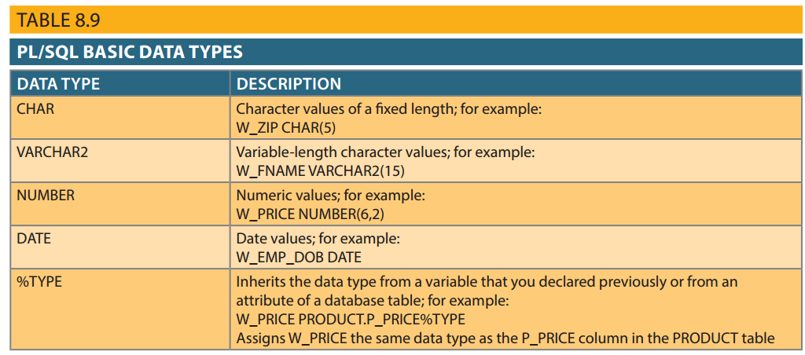
Table 8.9 - PL/SQL Basic Data Types
Copyright © 2017 Cengage Learning
7

Slide 8
Anonymous PL/SQL blocks
: Inserts a row in the vendor table with feedback message
SET SERVEROUTPUT ON
BEGIN
INSERT INTO VENDOR
VALUES (25772,'Clue Store','Issac Hayes','456','323-2009','VA','N');
DBMS_OUTPUT.PUT_LINE('New Vendor Added!');
END;
/
: PL/SQL variables and WHILE LOOP example
DECLARE
W_P1 NUMBER(3) := 0;
W_P2 NUMBER(3) := 10;
W_NUM NUMBER(2) := 0;
BEGIN
WHILE W_P2 < 300 LOOP
SELECT COUNT(P_CODE) INTO W_NUM FROM PRODUCT
WHERE P_PRICE BETWEEN W_P1 AND W_P2;
DBMS_OUTPUT.PUT_LINE('There are ' || W_NUM || ' Products with price between ' || W_P1 || ' and ' || W_P2);
W_P1 := W_P2 + 1;
W_P2 := W_P2 + 50;
END LOOP;
END;
/
Copyright © 2017 Cengage Learning
8

Slide 9
Procedure Example
CREATE OR REPLACE PROCEDURE PRC_CURSOR_EXAMPLE IS
W_P_CODE PRODUCT.P_CODE%TYPE;
W_P_DESCRIPT PRODUCT.P_DESCRIPT%TYPE;
W_TOT NUMBER(3);
CURSOR PROD_CURSOR IS
SELECT P_CODE, P_DESCRIPT
FROM PRODUCT
WHERE P_QOH > (SELECT AVG(P_QOH) FROM PRODUCT);
BEGIN
DBMS_OUTPUT.PUT_LINE('PRODUCTS WITH P_QOH > AVG(P_QOH)');
DBMS_OUTPUT.PUT_LINE('======================================');
OPEN PROD_CURSOR;
LOOP
FETCH PROD_CURSOR INTO W_P_CODE, W_P_DESCRIPT;
EXIT WHEN PROD_CURSOR%NOTFOUND;
DBMS_OUTPUT.PUT_LINE(W_P_CODE ||' -> ' || W_P_DESCRIPT );
END LOOP;
DBMS_OUTPUT.PUT_LINE('======================================');
DBMS_OUTPUT.PUT_LINE('TOTAL PRODUCT PROCESSED ' || PROD_CURSOR%ROWCOUNT);
DBMS_OUTPUT.PUT_LINE('--- END OF REPORT ----');
CLOSE PROD_CURSOR;
END;
/
Copyright © 2017 Cengage Learning
9

Slide 10
Triggers
Procedural SQL code automatically invoked by RDBMS on data manipulation event
Trigger definition:
Triggering timing: BEFORE or AFTER
Triggering event: INSERT, UPDATE, DELETE
Triggering level:
Statement-level trigger
Row-level trigger
Triggering action
DROP TRIGGER trigger_name
Copyright © 2017 Cengage Learning
10

Slide 11
Triggers
DROP TRIGGER trigger_name command
Deletes a trigger without deleting the table
Trigger action based on DML predicates
Actions depend on the type of DML statement that fires the trigger
CREATE OR REPLACE TRIGGER TRG_LINE_PROD
AFTER INSERT ON LINE
FOR EACH ROW
BEGIN
UPDATE PRODUCT
SET P_QOH = P_QOH - :NEW.LINE_UNITS
WHERE PRODUCT.P_CODE = :NEW.P_CODE;
END;
Copyright © 2017 Cengage Learning
11

Slide 12
Trigger Example
CREATE OR REPLACE TRIGGER TRG_LINE_CUS
AFTER INSERT ON LINE
FOR EACH ROW
DECLARE
W_CUS CHAR(5);
W_TOT NUMBER:= 0; -- to compute total cost
BEGIN
-- this trigger fires up after an INSERT of a LINE
-- it will update the CUS_BALANCE in CUSTOMER
-- 1) get the CUS_CODE
SELECT CUS_CODE INTO W_CUS
FROM INVOICE
WHERE INVOICE.INV_NUMBER = :NEW.INV_NUMBER;
-- 2) compute the total of the current line
W_TOT := :NEW.LINE_PRICE * :NEW.LINE_UNITS;
-- 3) Update the CUS_BALANCE in CUSTOMER
UPDATE CUSTOMER
SET CUS_BALANCE = CUS_BALANCE + W_TOT
WHERE CUS_CODE = W_CUS;
DBMS_OUTPUT.PUT_LINE(' * * * Balance updated for customer: ' || W_CUS);
END;
Copyright © 2017 Cengage Learning
12

Slide 13
Stored Procedures
Named collection of procedural and SQL statements
Advantages
Reduce network traffic and increase performance
Reduce code duplication by means of code isolation and code sharing
Copyright © 2017 Cengage Learning
13

Slide 14
PL/SQL Processing with Cursors
Cursor: Special construct used to hold data rows returned by a SQL query
Implicit cursor: Automatically created when SQL statement returns only one value
Explicit cursor: Holds the output of a SQL statement that may return two or more rows
Cursor-style processing involves retrieving data from the cursor one row at a time
Current row is copied to PL/SQL variables
Copyright © 2017 Cengage Learning
14

Slide 15
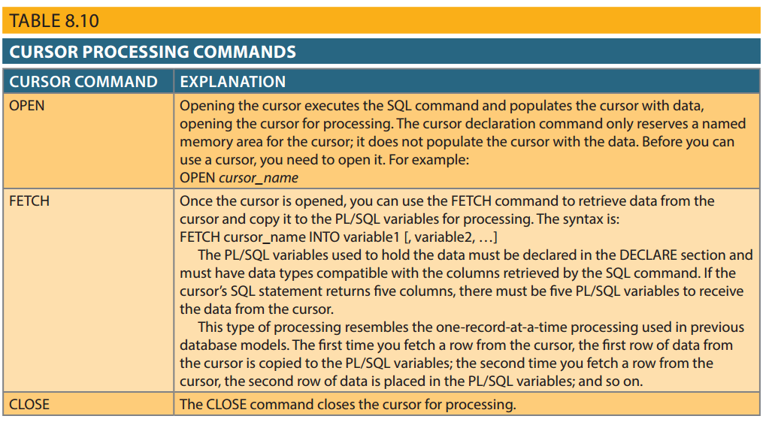
Table 8.10 - Cursor Processing Commands
Copyright © 2017 Cengage Learning
15

Slide 16
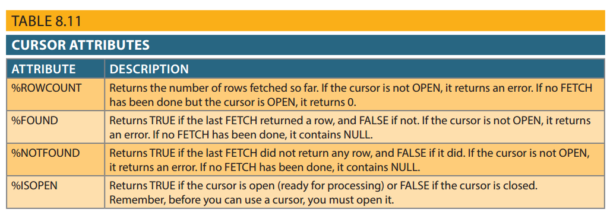
Table 8.11 - Cursor Attributes
Copyright © 2017 Cengage Learning
16

Slide 17
Cursor Procedure Example
CREATE OR REPLACE PROCEDURE PRC_CURSOR_EXAMPLE IS
W_P_CODE PRODUCT.P_CODE%TYPE;
W_P_DESCRIPT PRODUCT.P_DESCRIPT%TYPE;
W_TOT NUMBER(3);
CURSOR PROD_CURSOR IS
SELECT P_CODE, P_DESCRIPT
FROM PRODUCT
WHERE P_QOH > (SELECT AVG(P_QOH) FROM PRODUCT);
BEGIN
DBMS_OUTPUT.PUT_LINE('PRODUCTS WITH P_QOH > AVG(P_QOH)');
DBMS_OUTPUT.PUT_LINE('======================================');
OPEN PROD_CURSOR;
LOOP
FETCH PROD_CURSOR INTO W_P_CODE, W_P_DESCRIPT;
EXIT WHEN PROD_CURSOR%NOTFOUND;
DBMS_OUTPUT.PUT_LINE(W_P_CODE ||' -> ' || W_P_DESCRIPT );
END LOOP;
DBMS_OUTPUT.PUT_LINE('======================================');
DBMS_OUTPUT.PUT_LINE('TOTAL PRODUCT PROCESSED ' || PROD_CURSOR%ROWCOUNT);
DBMS_OUTPUT.PUT_LINE('--- END OF REPORT ----');
CLOSE PROD_CURSOR;
END;
/
Copyright © 2017 Cengage Learning
17

Slide 18
PL/SQL Stored Functions
Stored function: Named group of procedural and SQL statements that returns a value
As indicated by a RETURN statement in its program code
Can be invoked only from within stored procedures or triggers
Copyright © 2017 Cengage Learning
18

Slide 19
Embedded SQL
SQL statements contained within an application programming language
Host language: Any language that contains embedded SQL statements
Differences between SQL and procedural languages
Run-time mismatch
SQL is executed one instruction at a time
Host language runs at client side in its own memory space
Copyright © 2017 Cengage Learning
19

Slide 20
Embedded SQL
Processing mismatch
Conventional programming languages process one data element at a time
Newer programming environments manipulate data sets in a cohesive manner
Data type mismatch
Data types provided by SQL might not match data types used in different host languages
Copyright © 2017 Cengage Learning
20

Slide 21
Embedded SQL
Embedded SQL framework defines:
Standard syntax to identify embedded SQL code within the host language
Standard syntax to identify host variables
Communication area used to exchange status and error information between SQL and host language
Copyright © 2017 Cengage Learning
21

Slide 22
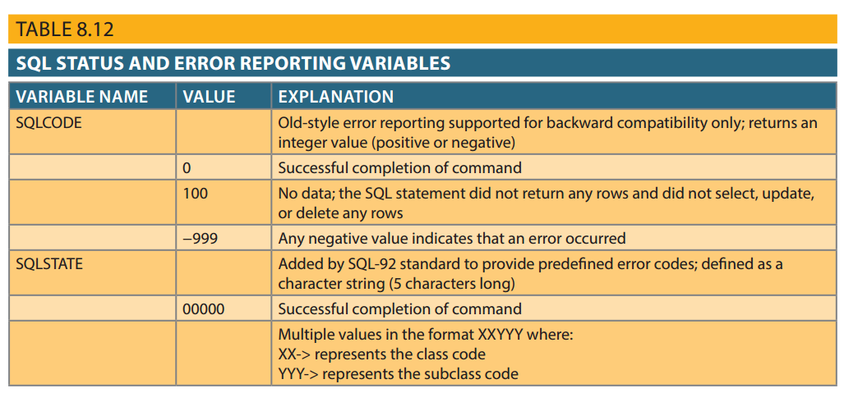
Table 8.12 - SQL Status and Error Reporting Variables
Copyright © 2017 Cengage Learning
22

Slide 23
Embedded SQL (cont’d.)
Static SQL
Embedded SQL in which programmer uses predefined SQL statements and parameters
End users of programs are limited to actions that were specified in application programs
SQL statements will not change while application is running
We will see this in the Online Survey System in the lecture on Web-based Systems
Copyright © 2017 Cengage Learning
23

Slide 24
Embedded SQL (cont’d.)
Dynamic SQL
SQL statement is not known in advance, but instead is generated at run time
Program can generate SQL statements at run time that are required to respond to ad hoc queries
Attribute list and condition are not known until end user specifies them
Tends to be much slower than static SQL
Requires more computer resources
Copyright © 2017 Cengage Learning
24

Slide 25
Summary
PL/SQL can be used to create triggers, stored procedures, and PL/SQL functions
A stored procedure is a named collection of SQL statements
When SQL statements return more than one value inside the PL/SQL code, cursor is needed
Embedded SQL uses SQL statements within an application programming language
Copyright © 2017 Cengage Learning
25

Slide 26
Task
Carefully review the procedure on slide 17 to answer the following questions.
How many attributes are returned by the cursor? ____
What is the end condition of the loop? __________
What does the procedure do (2 sentences)?
Copyright © 2017 Cengage Learning
26

